Slide 1
3D Translation
Consider a point object O has to be moved from one position to another in a 3D plane.
Let
Initial coordinates of the object O = (X_{old}, Y_{old}, Z_{old})
New coordinates of the object O after translation = (X_{new}, Y_{new}, Z_{old})
Translation vector or Shift vector = (T_{x}, T_{y}, T_{z})
Given a Translation vector (T_{x}, T_{y}, T_{z})-
T_{x} defines the distance the X_{old} coordinate has to be moved.
T_{y} defines the distance the Y_{old} coordinate has to be moved.
T_{z} defines the distance the Z_{old} coordinate has to be moved.

Slide 2
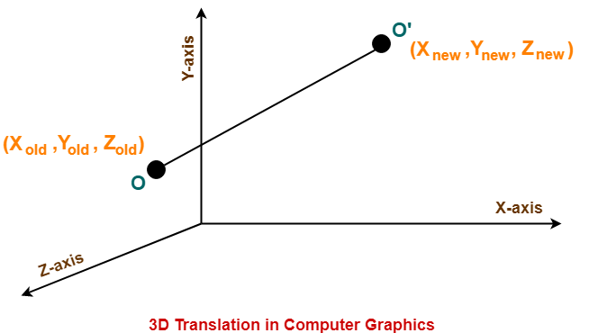

Slide 3
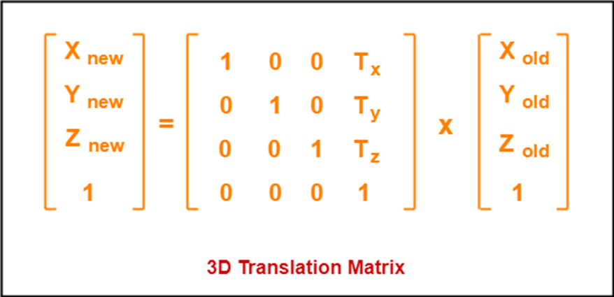
3D Translation
This translation is achieved by adding the translation coordinates to the old coordinates of the object as
X_{new} = X_{old} + T_{x} (This denotes translation towards X axis)
Y_{new} = Y_{old} + T_{y} (This denotes translation towards Y axis)
Z_{new} = Z_{old} + T_{z} (This denotes translation towards Z axis)

Slide 4
Problem
Given a 3D object with coordinate points A(0, 3, 1), B(3, 3, 2), C(3, 0, 0), D(0, 0, 0). Apply the translation with the distance 1 towards X axis, 1 towards Y axis and 2 towards Z axis and obtain the new coordinates of the object.
Solution
Given
Old coordinates of the object = A (0, 3, 1), B(3, 3, 2), C(3, 0, 0), D(0, 0, 0)
Translation vector = (T_{x}, T_{y}, T_{z}) = (1, 1, 2)

Slide 5
For Coordinates A(0, 3, 1)
Let the new coordinates of A = (X_{new}, Y_{new}, Z_{new}).
Applying the translation equations, we have
X_{new} = X_{old} + T_{x} = 0 + 1 = 1
Y_{new} = Y_{old} + T_{y} = 3 + 1 = 4
Z_{new} = Z_{old} + T_{z} = 1 + 2 = 3
Thus, New coordinates of A = (1, 4, 3).

Slide 6
For Coordinates B(3, 3, 2)
Let the new coordinates of B = (X_{new}, Y_{new}, Z_{new}).
Applying the translation equations, we have-
X_{new} = X_{old} + T_{x} = 3 + 1 = 4
Y_{new} = Y_{old} + T_{y} = 3 + 1 = 4
Z_{new} = Z_{old} + T_{z} = 2 + 2 = 4
Thus, New coordinates of B = (4, 4, 4).

Slide 7
For Coordinates C(3, 0, 0)
Let the new coordinates of C = (X_{new}, Y_{new}, Z_{new}).
Applying the translation equations, we have-
X_{new} = X_{old} + T_{x} = 3 + 1 = 4
Y_{new} = Y_{old} + T_{y} = 0 + 1 = 1
Z_{new} = Z_{old} + T_{z} = 0 + 2 = 2
Thus, New coordinates of C = (4, 1, 2).

Slide 8
For Coordinates D(0, 0, 0)
Let the new coordinates of D = (X_{new}, Y_{new}, Z_{new}).
Applying the translation equations, we have-
X_{new} = X_{old} + T_{x} = 0 + 1 = 1
Y_{new} = Y_{old} + T_{y} = 0 + 1 = 1
Z_{new} = Z_{old} + T_{z} = 0 + 2 = 2
Thus, New coordinates of D = (1, 1, 2).
Thus, New coordinates of the object = A (1, 4, 3), B(4, 4, 4), C(4, 1, 2), D(1, 1, 2).

Slide 9
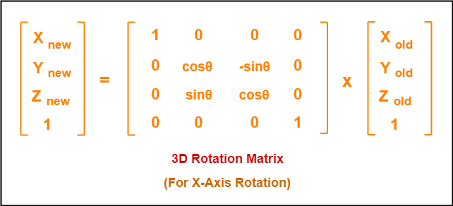
3D Rotation
Consider a point object O has to be rotated from one angle to another in a 3D plane.
Let
Initial coordinates of the object O = (X_{old}, Y_{old}, Z_{old})
Initial angle of the object O with respect to origin = Φ
Rotation angle = θ
New coordinates of the object O after rotation = (X_{new}, Y_{new}, Z_{new})
In 3 dimensions, there are 3 possible types of rotation
X-axis Rotation
Y-axis Rotation
Z-axis Rotation
For X-Axis Rotation
This rotation is achieved by using the following rotation equations-
X_{new} = X_{old}
Y_{new} = Y_{old} x cosθ – Z_{old} x sinθ
Z_{new} = Y_{old} x sinθ + Z_{old} x cosθ

Slide 10
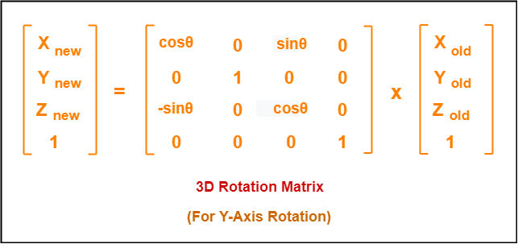
For Y-Axis Rotation
This rotation is achieved by using the following rotation equations-
X_{new} = Z_{old} x sinθ + X_{old} x cosθ
Y_{new} = Y_{old}
Z_{new} = Y_{old} x cosθ – X_{old} x sinθ
In Matrix form, the above rotation equations may be represented as

Slide 11
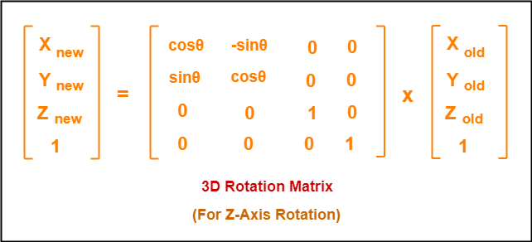
For Z-Axis Rotation
This rotation is achieved by using the following rotation equations-
X_{new} = X_{old} x cosθ - Y_{old} sinθ
Y_{new} = X_{old} sinθ + Y_{old} cosθ
Z_{new} = Y_{old}
In Matrix form, the above rotation equations may be represented as

Slide 12
Problem-01:
Given a homogeneous point (1, 2, 3). Apply rotation 90 degree towards X, Y and Z axis and find out the new coordinate points.
Solution
Given-
Old coordinates = (X_{old}, Y_{old}, Z_{old}) = (1, 2, 3)
Rotation angle = θ = 90º

Slide 13
For X-Axis Rotation-
Let the new coordinates after rotation = (X_{new}, Y_{new}, Z_{new}).
Applying the rotation equations, we have-
X_{new} = X_{old} = 1
Y_{new} = Y_{old} x cosθ – Z_{old} x sinθ = 2 x cos90° – 3 x sin90° = 2 x 0 – 3 x 1 = -3
Z_{new} = Y_{old} x sinθ + Z_{old} x cosθ = 2 x sin90° + 3 x cos90° = 2 x 1 + 3 x 0 = 2
Thus, New coordinates after rotation = (1, -3, 2).
For Y-Axis Rotation-
Let the new coordinates after rotation = (X_{new}, Y_{new}, Z_{new}).
Applying the rotation equations, we have-
X_{new} = Z_{old} x sinθ + X_{old} x cosθ = 3 x sin90° + 1 x cos90° = 3 x 1 + 1 x 0 = 3
Y_{new} = Y_{old} = 2
Z_{new} = Y_{old} x cosθ – X_{old} x sinθ = 2 x cos90° – 1 x sin90° = 2 x 0 – 1 x 1 = -1
Thus, New coordinates after rotation = (3, 2, -1).

Slide 14
For Z-Axis Rotation
Let the new coordinates after rotation = (X_{new}, Y_{new}, Z_{new}).
Applying the rotation equations, we have-
X_{new} = X_{old} x cosθ – Y_{old} x sinθ = 1 x cos90° – 2 x sin90° = 1 x 0 – 2 x 1 = -2
Y_{new} = X_{old} x sinθ + Y_{old} x cosθ = 1 x sin90° + 2 x cos90° = 1 x 1 + 2 x 0 = 1
Z_{new} = Z_{old} = 3
Thus, New coordinates after rotation = (-2, 1, 3).

Slide 15
3D Scaling
Scaling may be used to increase or reduce the size of object.
Scaling subjects the coordinate points of the original object to change.
Scaling factor determines whether the object size is to be increased or reduced.
If scaling factor > 1, then the object size is increased.
If scaling factor < 1, then the object size is reduced.
Consider a point object O has to be scaled in a 3D plane.
Let
Initial coordinates of the object O = (X_{old}, Y_{old},Z_{old})
Scaling factor for X-axis = S_{x}
Scaling factor for Y-axis = S_{y}
Scaling factor for Z-axis = S_{z}
New coordinates of the object O after scaling = (X_{new}, Y_{new}, Z_{new})

Slide 16
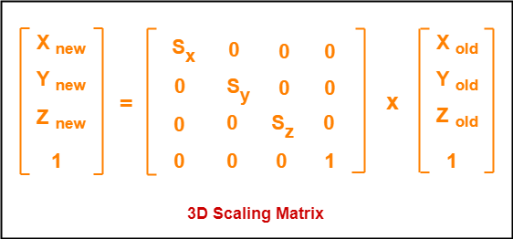
This scaling is achieved by using the following scaling equations
X_{new} = X_{old} x S_{x}
Y_{new} = Y_{old} x S_{y}
Z_{new} = Z_{old} x S_{z}
In Matrix form, the above scaling equations may be represented as

Slide 17
Problem-01:
Given a 3D object with coordinate points A(0, 3, 3), B(3, 3, 6), C(3, 0, 1), D(0, 0, 0). Apply the scaling parameter 2 towards X axis, 3 towards Y axis and 3 towards Z axis and obtain the new coordinates of the object.
Solution
Given
Old coordinates of the object = A (0, 3, 3), B(3, 3, 6), C(3, 0, 1), D(0, 0, 0)
Scaling factor along X axis = 2
Scaling factor along Y axis = 3
Scaling factor along Z axis = 3

Slide 18
For Coordinates A(0, 3, 3)
Let the new coordinates of A after scaling = (X_{new}, Y_{new}, Z_{new}).
Applying the scaling equations, we have-
X_{new} = X_{old} x S_{x} = 0 x 2 = 0
Y_{new} = Y_{old} x S_{y} = 3 x 3 = 9
Z_{new} = Z_{old} x S_{z} = 3 x 3 = 9
Thus, New coordinates of corner A after scaling = (0, 9, 9).
For Coordinates B(3, 3, 6)
Let the new coordinates of B after scaling = (X_{new}, Y_{new}, Z_{new}).
Applying the scaling equations, we have-
X_{new} = X_{old} x S_{x} = 3 x 2 = 6
Y_{new} = Y_{old} x S_{y} = 3 x 3 = 9
Z_{new} = Z_{old} x S_{z} = 6 x 3 = 18
Thus, New coordinates of corner B after scaling = (6, 9, 18).

Slide 19
For Coordinates C(3, 0, 1)
Let the new coordinates of C after scaling = (X_{new}, Y_{new}, Z_{new}).
Applying the scaling equations, we have-
X_{new} = X_{old} x S_{x} = 3 x 2 = 6
Y_{new} = Y_{old} x S_{y} = 0 x 3 = 0
Z_{new} = Z_{old} x S_{z} = 1 x 3 = 3
Thus, New coordinates of corner C after scaling = (6, 0, 3).
For Coordinates D(0, 0, 0)
Let the new coordinates of D after scaling = (X_{new}, Y_{new}, Z_{new}).
Applying the scaling equations, we have-
X_{new} = X_{old} x S_{x} = 0 x 2 = 0
Y_{new} = Y_{old} x S_{y} = 0 x 3 = 0
Z_{new} = Z_{old} x S_{z} = 0 x 3 = 0
Thus, New coordinates of corner D after scaling = (0, 0, 0).

Slide 20
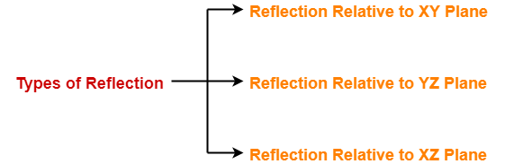
3D Reflection
Reflection is a kind of rotation where the angle of rotation is 180 degree.
The reflected object is always formed on the other side of mirror.
The size of reflected object is same as the size of original object.
Consider a point object O has to be reflected in a 3D plane.
Let
Initial coordinates of the object O = (X_{old}, Y_{old}, Z_{old})
New coordinates of the reflected object O after reflection = (X_{new}, Y_{new},Z_{new})
In 3 dimensions, there are 3 possible types of reflection-

Slide 21
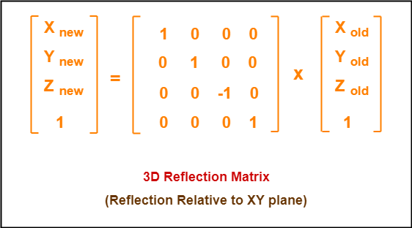
Reflection Relative to XY Plane:
This reflection is achieved by using the following reflection equations
X_{new} = X_{old}
Y_{new} = Y_{old}
Z_{new} = -Z_{old}
In Matrix form, the above reflection equations may be represented as

Slide 22
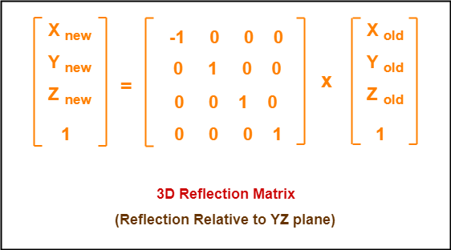
Reflection Relative to YZ Plane:
This reflection is achieved by using the following reflection equations-
X_{new} = -X_{old}
Y_{new} = Y_{old}
Z_{new} = Z_{old}
In Matrix form, the above reflection equations may be represented as

Slide 23
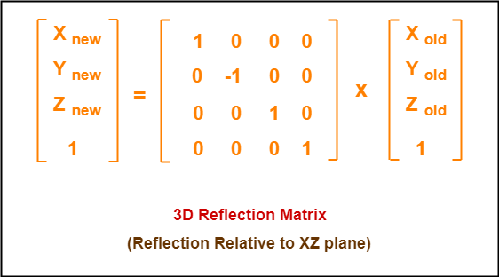
Reflection Relative to XZ Plane:
This reflection is achieved by using the following reflection equations
X_{new} = X_{old}
Y_{new} = -Y_{old}
Z_{new} = Z_{old}
In Matrix form, the above reflection equations may be represented as

Slide 24
Problem-01:
Given a 3D triangle with coordinate points A(3, 4, 1), B(6, 4, 2), C(5, 6, 3). Apply the reflection on the XY plane and find out the new coordinates of the object.
Solution
Given
Old corner coordinates of the triangle = A (3, 4, 1), B(6, 4, 2), C(5, 6, 3)
Reflection has to be taken on the XY plane

Slide 25
For Coordinates A(3, 4, 1)
Let the new coordinates of corner A after reflection = (X_{new}, Y_{new}, Z_{new}).
Applying the reflection equations, we have-
X_{new} = X_{old} = 3
Y_{new} = Y_{old} = 4
Z_{new} = -Z_{old} = -1
Thus, New coordinates of corner A after reflection = (3, 4, -1).
For Coordinates B(6, 4, 2)
Let the new coordinates of corner B after reflection = (X_{new}, Y_{new}, Z_{new}).
Applying the reflection equations, we have-
X_{new} = X_{old} = 6
Y_{new} = Y_{old} = 4
Z_{new} = -Z_{old} = -2
Thus, New coordinates of corner B after reflection = (6, 4, -2).

Slide 26
For Coordinates C(5, 6, 3)
Let the new coordinates of corner C after reflection = (X_{new}, Y_{new}, Z_{new}).
Applying the reflection equations, we have-
X_{new} = X_{old} = 5
Y_{new} = Y_{old} = 6
Z_{new} = -Z_{old} = -3
Thus, New coordinates of corner C after reflection = (5, 6, -3).
Thus, New coordinates of the triangle after reflection = A (3, 4, -1), B(6, 4, -2), C(5, 6, -3).

Slide 27
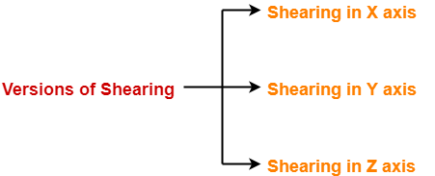
3D Shearing
In a three dimensional plane, the object size can be changed along X direction, Y direction as well as Z direction.
So, there are three versions of shearing
Consider a point object O has to be sheared in a 3D plane.
Let
Initial coordinates of the object O = (X_{old}, Y_{old}, Z_{old})
Shearing parameter towards X direction = Sh_{x}
Shearing parameter towards Y direction = Sh_{y}
Shearing parameter towards Z direction = Sh_{z}
New coordinates of the object O after shearing = (X_{new}, Y_{new}, Z_{new})

Slide 28
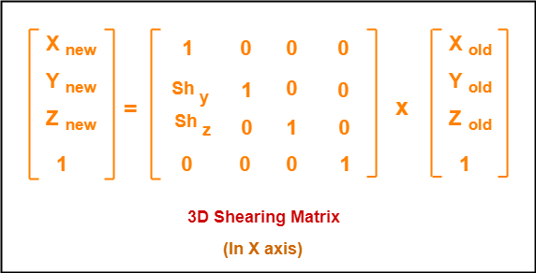
Shearing in X Axis
Shearing in X axis is achieved by using the following shearing equations
X_{new} = X_{old}
Y_{new} = Y_{old} + Sh_{y} x X_{old}
Z_{new} = Z_{old} + Sh_{z} x X_{old}
In Matrix form, the above shearing equations may be represented as

Slide 29
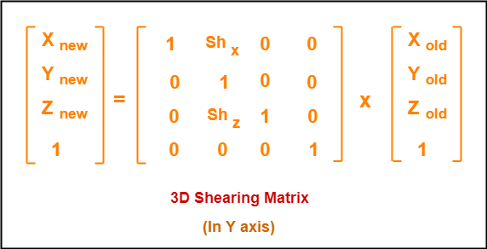
Shearing in Y Axis
Shearing in Y axis is achieved by using the following shearing equations
X_{new} = X_{old} + Sh_{x} x Y_{old}
Y_{new} = Y_{old}
Z_{new} = Z_{old} + Sh_{z} x Y_{old}
In Matrix form, the above shearing equations may be represented as

Slide 30
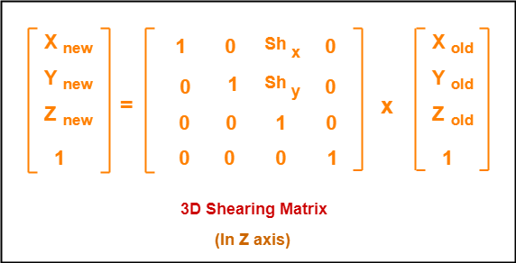
Shearing in Z Axis
Shearing in Z axis is achieved by using the following shearing equations
X_{new} = X_{old} + Sh_{x} x Z_{old}
Y_{new} = Y_{old} + Sh_{y} x Z_{old}
Z_{new} = Z_{old}
In Matrix form, the above shearing equations may be represented as

Slide 31
Problem-01:
Given a 3D triangle with points (0, 0, 0), (1, 1, 2) and (1, 1, 3). Apply shear parameter 2 on X axis, 2 on Y axis and 3 on Z axis and find out the new coordinates of the object.
Solution
Given
Old corner coordinates of the triangle = A (0, 0, 0), B(1, 1, 2), C(1, 1, 3)
Shearing parameter towards X direction (Sh_{x}) = 2
Shearing parameter towards Y direction (Sh_{y}) = 2
Shearing parameter towards Y direction (Sh_{z}) = 3

Slide 32
Shearing in X Axis
For Coordinates A(0, 0, 0)
Let the new coordinates of corner A after shearing = (X_{new}, Y_{new}, Z_{new}).
Applying the shearing equations, we have-
X_{new} = X_{old} = 0
Y_{new} = Y_{old} + Sh_{y} x X_{old} = 0 + 2 x 0 = 0
Z_{new} = Z_{old} + Sh_{z} x X_{old} = 0 + 3 x 0 = 0
Thus, New coordinates of corner A after shearing = (0, 0, 0).
For Coordinates B(1, 1, 2)
Let the new coordinates of corner B after shearing = (X_{new}, Y_{new}, Z_{new}).
Applying the shearing equations, we have-
X_{new} = X_{old} = 1
Y_{new} = Y_{old} + Sh_{y} x X_{old} = 1 + 2 x 1 = 3
Z_{new} = Z_{old} + Sh_{z} x X_{old} = 2 + 3 x 1 = 5
Thus, New coordinates of corner B after shearing = (1, 3, 5).

Slide 33
Shearing in X Axis
For Coordinates C(1, 1, 3)
Let the new coordinates of corner C after shearing = (X_{new}, Y_{new}, Z_{new}).
Applying the shearing equations, we have-
X_{new} = X_{old} = 1
Y_{new} = Y_{old} + Sh_{y} x X_{old} = 1 + 2 x 1 = 3
Z_{new} = Z_{old} + Sh_{z} x X_{old} = 3 + 3 x 1 = 6
Thus, New coordinates of corner C after shearing = (1, 3, 6).
Thus, New coordinates of the triangle after shearing in X axis = A (0, 0, 0), B(1, 3, 5), C(1, 3, 6).

Slide 34
Shearing in Y Axis
For Coordinates C(1, 1, 3)
Let the new coordinates of corner C after shearing = (X_{new}, Y_{new}, Z_{new}).
Applying the shearing equations, we have-
X_{new} = X_{old} + Sh_{x} x Y_{old} = 1 + 2 x 1 = 3
Y_{new} = Y_{old} = 1
Z_{new} = Z_{old} + Sh_{z} x Y_{old} = 3 + 3 x 1 = 6
Thus, New coordinates of corner C after shearing = (3, 1, 6).
Thus, New coordinates of the triangle after shearing in Y axis = A (0, 0, 0), B(3, 1, 5), C(3, 1, 6).

Slide 35
Shearing in Z Axis
For Coordinates A(0, 0, 0)
Let the new coordinates of corner A after shearing = (X_{new}, Y_{new}, Z_{new}).
Applying the shearing equations, we have-
X_{new} = X_{old} + Sh_{x} x Z_{old} = 0 + 2 x 0 = 0
Y_{new} = Y_{old} + Sh_{y} x Z_{old} = 0 + 2 x 0 = 0
Z_{new} = Z_{old} = 0
Thus, New coordinates of corner A after shearing = (0, 0, 0).
For Coordinates B(1, 1, 2)
Let the new coordinates of corner B after shearing = (X_{new}, Y_{new}, Z_{new}).
Applying the shearing equations, we have-
X_{new} = X_{old} + Sh_{x} x Z_{old} = 1 + 2 x 2 = 5
Y_{new} = Y_{old} + Sh_{y} x Z_{old} = 1 + 2 x 2 = 5
Z_{new} = Z_{old} = 2
Thus, New coordinates of corner B after shearing = (5, 5, 2).

Slide 36
Shearing in Z Axis
For Coordinates C(1, 1, 3)
Let the new coordinates of corner C after shearing = (X_{new}, Y_{new}, Z_{new}).
Applying the shearing equations, we have-
X_{new} = X_{old} + Sh_{x} x Z_{old} = 1 + 2 x 3 = 7
Y_{new} = Y_{old} + Sh_{y} x Z_{old} = 1 + 2 x 3 = 7
Z_{new} = Z_{old} = 3
Thus, New coordinates of corner C after shearing = (7, 7, 3).
Thus, New coordinates of the triangle after shearing in Z axis = A (0, 0, 0), B(5, 5, 2), C(7, 7, 3).

